Slide 1


Image-Based Text Steganography Using Basic Python
Youssef sameh
202400436

Slide 2

Introduction to steganography
Definition: concealing a secret message inside a normal picture
Unlike cryptography, it hides the existence of the message itself

Slide 3

Project purpose
Goal: creating a python program that can encode and decode a text in an image
Requirements: must be created with basic programming functions without using libraries
Type of data: the image has to be .BMP

Slide 4

High level app mechanisms
Method: least significant bit steganography
  The messages bits are put into the LSB of the image's pixel bytes
  Editing LSB causes minimal changes to the pixels making it unnoticeable to the human eye

Slide 5
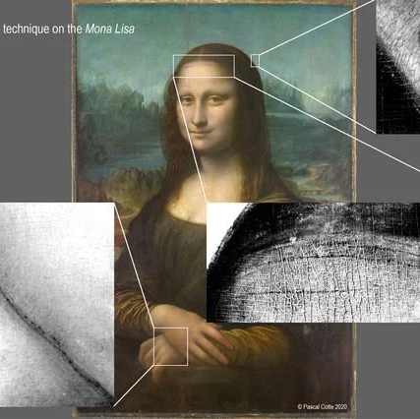
Encoding
Prepare data: convert text and delimiter into bits
Find start: read image file and find where the picture data starts
Check size: make sure the message is not too long for the image
Replace bits: loop through picture data, replacing the last bit of each pixel byte with one bit of the message
Save: save the ne encoded image

Slide 6

decoding
Read image: open the encoded image
Collect bits: start going through picture data and extract only the last bit from every byte
Look for end: keep extracting until the delimiter is found
Convert back to text and print:
  Remove delimiter bits
  Group to 8 bit blocks
  Turn to bytes then to text
  Print final message found

Slide 7
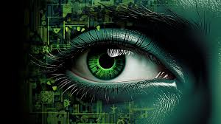
Conclusion
Result: successfully built a working steganography program only suing simple python
Skills learnt: file handling, and learning new file formats

Slide 8

Thank you

